Slide 1
Object Oriented Programming

Slide 2
Overview of OOP
As the name suggests, Object-Oriented Programming or OOPs refers to languages that use objects in programming.
Object-oriented programming aims to implement real-world entities like inheritance, hiding, polymorphism, etc. in programming.
The main aim of OOP is to bind together the data and the functions that operate on them so that no other part of the code can access this data except that function.
Examples of OOP languages are : C++, Java, Python

Slide 3
Need for OOP
Disadvantages of Procedural Programming
The code reusability feature is not present in procedural-oriented programming. We have to rewrite the same programming code many times.
Difficult to relate to real-world objects.
We can not perform operations like encapsulation, inheritance, etc.
To overcome these disadvantages, Object Oriented approach was developed.
Why do we need object-oriented programming
To make the development and maintenance of projects more effortless.
To provide the feature of data hiding that is good for security concerns.
We can solve real-world problems if we are using object-oriented programming.
It ensures code reusability.
It lets us write generic code: which will work with a range of data, so we don’t have to write basic stuff over and over again.

Slide 4
OOP Concepts
Class
Objects
Data Abstraction
Encapsulation
Inheritance
Polymorphism

Slide 5
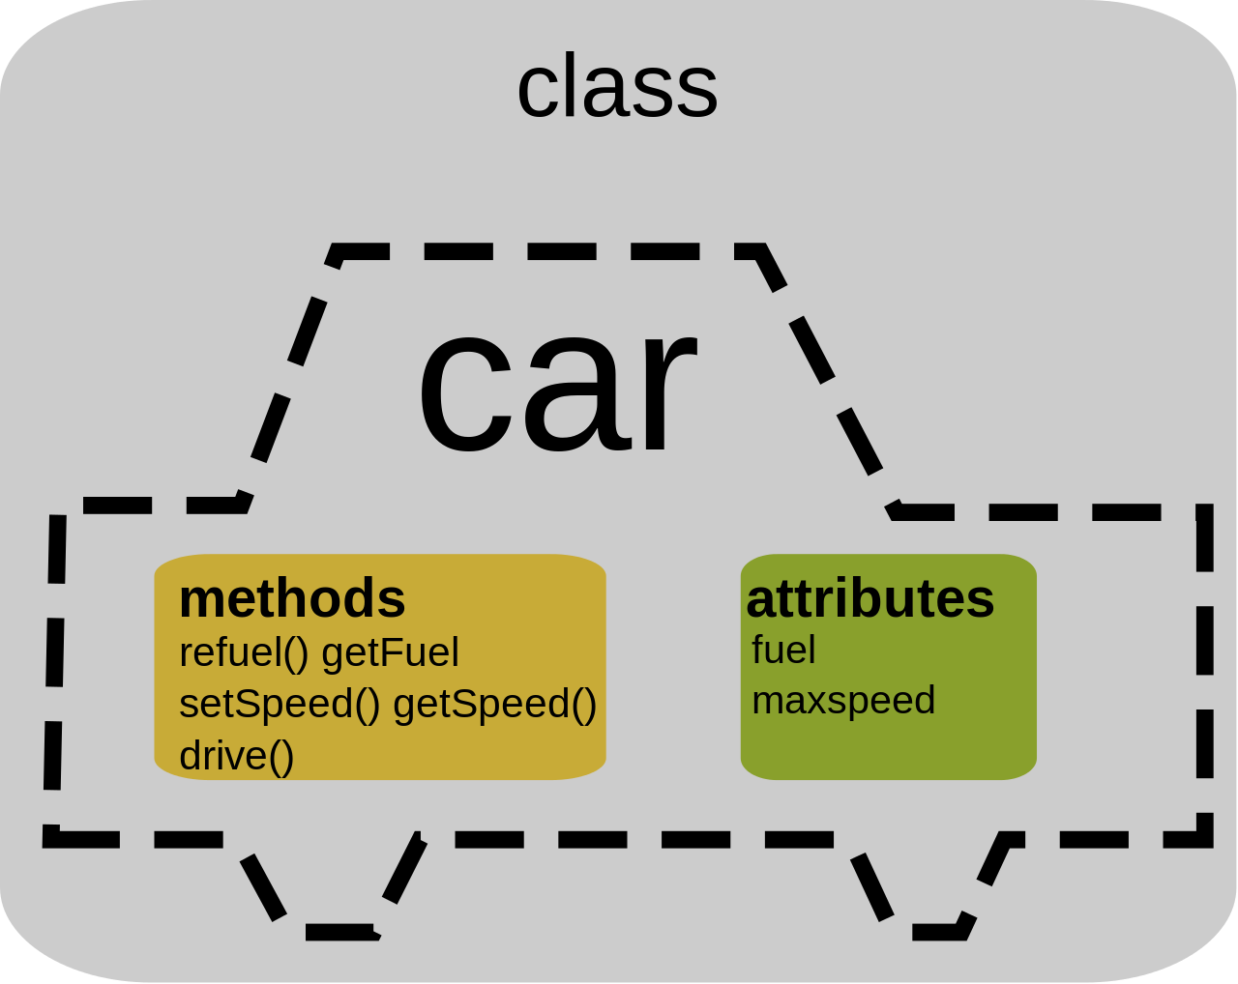
Class
A class is a user-defined data type.
It consists of data members and member functions, which can be accessed and used by creating an instance of that class.
It represents the set of properties or methods that are common to all objects of one type.
A class is like a blueprint for an object.
Eg : Car is the class, and wheels, speed limits, mileage are their properties.

Slide 6
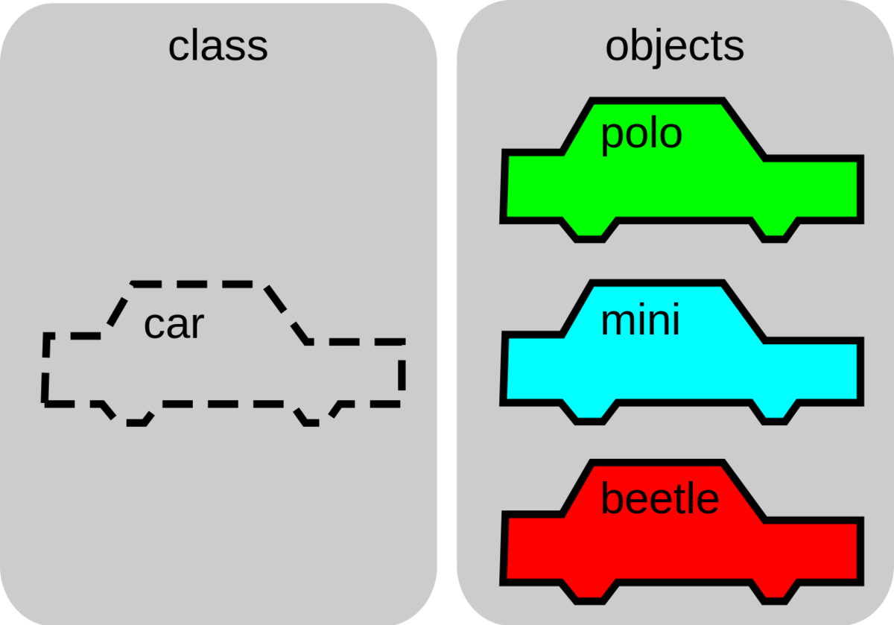
Object
It is a basic unit of Object-Oriented Programming and represents the real-life entities.
An Object is an instance of a Class.
When a class is defined, no memory is allocated but when it is instantiated (i.e. an object is created) memory is allocated.
An object has an identity, state, and behavior.
Each object contains data and code to manipulate the data.
Objects can interact without having to know details of each other’s data or code
Eg : Audi, BMW are objects of class Car

Slide 7
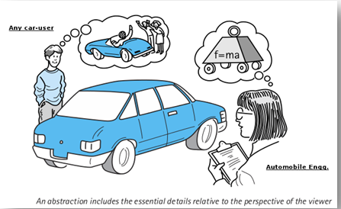
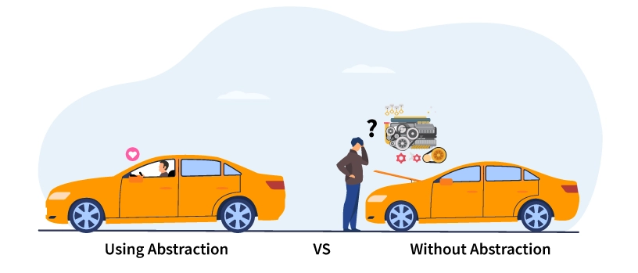
Data Abstraction
Data abstraction is one of the most essential and important features of object-oriented programming.
Data abstraction refers to providing only essential information about the data to the outside world, hiding the background details or implementation.
This helps to achieve security.
Eg : A man driving a car and pushing accelerator or applying brakes, Withdrawing cash from an ATM Machine, using any app on mobile phone.

Slide 8
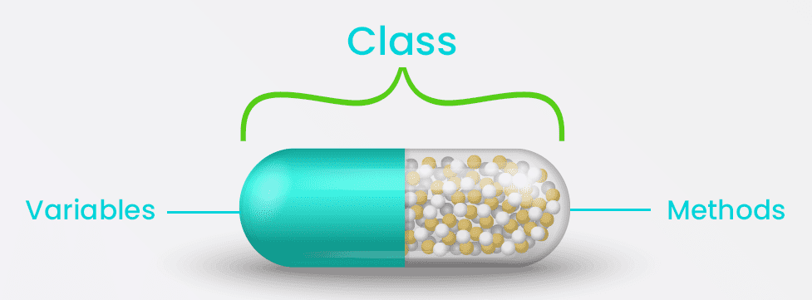
Encapsulation
Encapsulation is defined as the wrapping up of data under a single unit.
It is the mechanism that binds together code and the data it manipulates.
In Encapsulation, the variables or data of a class are hidden from any other class and can be accessed only through any member function of their class in which they are declared.
As in encapsulation, the data in a class is hidden from other classes, so it is also known as data-hiding.
A class is an example of encapsulation
Eg : Consider a real-life example of encapsulation, in a company, there are different sections like the accounts section, finance section, sales section and an official from sales wants to access any document belonging to finance dept.

Slide 9
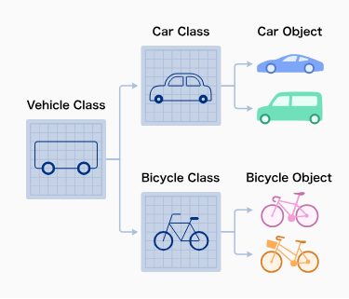
Inheritance
Inheritance is an important pillar of OOP(Object-Oriented Programming).
The capability of a class to derive properties and characteristics from another class is called Inheritance.
When we write a class, we inherit properties from other classes.
So when we create a class, we do not need to write all the properties and functions again and again, as these can be inherited from another class that possesses it.
Inheritance allows the user to reuse the code whenever possible and reduce its redundancy.

Slide 10
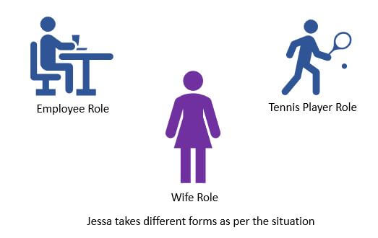
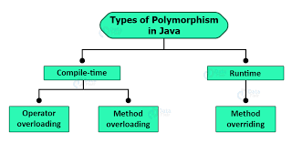
Polymorphism
The word polymorphism means having many forms.
In simple words, we can define polymorphism as the ability of a message to be displayed in more than one form.
For example, A person at the same time can have different characteristics. Like a man at the same time is a father, a husband, an employee. So the same person posses different behavior in different situations. This is called polymorphism.

Slide 11
Benefits of OOP
Modularity : Encapsulation enables objects to be self-contained, making troubleshooting and collaborative development easier.
Reusability : Code can be reused through inheritance, meaning a team does not have to write the same code multiple times.
Productivity : Programmers can construct new programs quicker through the use of multiple libraries and reusable code.
Easily upgradable and scalable : Programmers can implement system functionalities independently.
Interface descriptions : Descriptions of external systems are simple, due to message passing techniques that are used for objects communication.
Security : Using encapsulation and abstraction, complex code is hidden, software maintenance is easier and internet protocols are protected.
Flexibility : Polymorphism enables a single function to adapt to the class it is placed in. Different objects can also pass through the same interface.

Slide 12
Criticism of OOP
The object-oriented programming model has been criticized by developers for multiple reasons.
The largest concern is that OOP overemphasizes the data component of software development and does not focus enough on computation or algorithms.
Additionally, OOP code may be more complicated to write
OOP codes takes longer to compile.

Slide 13
JAVA PROGRAMMING
Chap 1 : Java Fundamentals

Slide 14
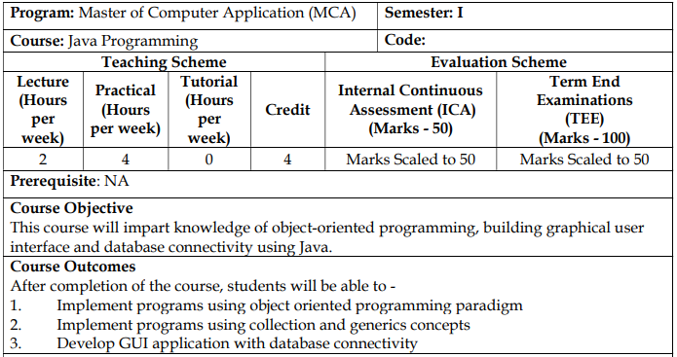

Slide 15
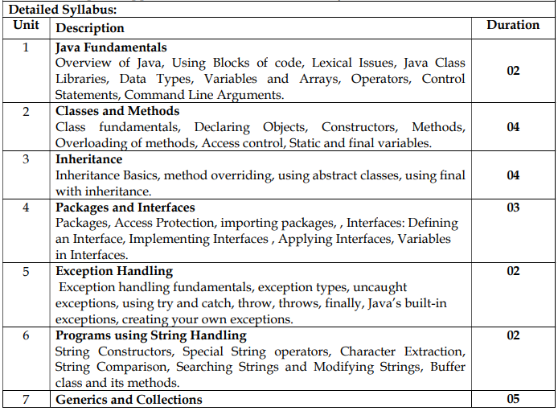

Slide 16
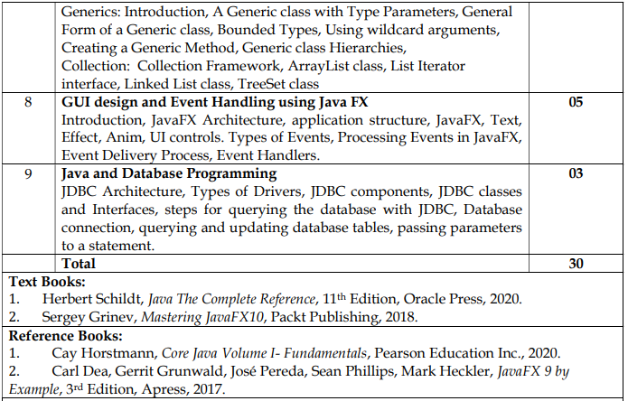

Slide 17
Java is a programming language and a platform.
Java is a high level, robust, object-oriented and secure programming language.
Java was developed by Sun Microsystems (which is now the subsidiary of Oracle) in the year 1995.
James Gosling is known as the father of Java.
Before Java, its name was Oak. Since Oak was already a registered company, so James Gosling and his team changed the name from Oak to Java.

Slide 18
There are mainly 4 types of applications that can be created using Java programming:
1) Standalone Application : Also known as desktop applications or window-based applications are traditional software that we need to install on every machine. Examples of standalone application are Media player, antivirus, etc. AWT and Swing are used in Java for creating standalone applications.
2) Web Application : An application that runs on the server side and creates a dynamic page is called a web application. Currently, Servlet, JSP, Struts, Spring, Hibernate, JSF, etc. technologies are used for creating web applications in Java.
3) Enterprise Application : An application that is distributed in nature, such as banking applications, etc. is called an enterprise application. It has advantages like high-level security, load balancing, and clustering. In Java, EJB is used for creating enterprise applications.
4) Mobile Application : An application which is created for mobile devices is called a mobile application. Currently, Android and Java ME are used for creating mobile applications.

Slide 19
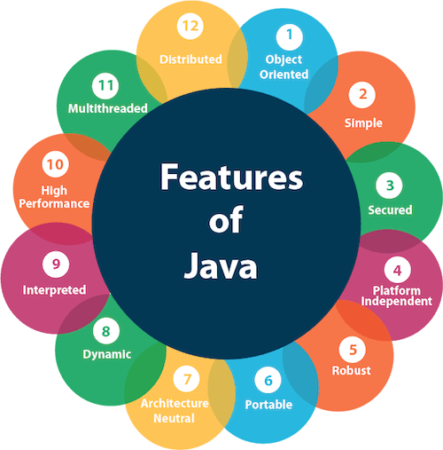
Features of Java
Simple - (No pointers, no operator overloading, no garbage collection, no multiple inheritance)
Object-Oriented
Portable - (bytecode)
Platform independent - (bytecode)
Secured - (no explicit pointer)
Robust - (strong MM Mgmt, Exception Handling, Auto Garbage Collection, no pointers)
Architecture neutral - (bytecode, fixed size of primitive datatypes)
Interpreted
High Performance
Multithreaded
Distributed - (helps to create distributed applns using RMI & EJB)
Dynamic - (uses JIT)
Garbage Collected

Slide 20
Basic concepts of OOPs are:
Object
Class
Inheritance
Polymorphism
Abstraction
Encapsulation

Slide 21
C++ | Java
It is object oriented but not purely. That is a program can be written in C++ without using classes and objects. | It is purely object oriented that is no program can be written without classes and objects.
C++ is platform dependent | Java is platform independent
C++ supports the goto statement. | Java doesn’t support the goto statement.
C++ supports pointers. This makes program system dependent. | Java doesn’t support pointers to avoid platform dependency.
C++ supports multiple and hybrid inheritance | Java does not support multiple and hybrid inheritance. A slight implementation of the same can be done using a special feature called as Interface.
Supports operator overloading | Does not allow operator overloading
Supports 3 access specifiers : public, protected and private | Supports 5 access specifiers : public, protected, private, default and private protected
Destructors are used in C++ | Java is garbage collected that is the objects are automatically destroyed once their use is over
C++ doesn’t have exception handling | Java has exception handling
Doesn’t support multithreading | Supports multithreading

Slide 22
C++ | Java
C++ uses compiler only. C++ is compiled and run using the compiler which converts source code into machine code so, C++ is platform dependent. | Java uses both compiler and interpreter. Java source code is converted into bytecode at compilation time. The interpreter executes this bytecode at runtime and produces output. Java is interpreted that is why it is platform-independent.
C++ supports structures and unions. | Java doesn't support structures and unions
C++ doesn't support documentation comments. | Java supports documentation comment (/** ... */) to create documentation for java source code.
Has header files | uses the import keyword to include different classes and methods
mainly used for system programming. | mainly used for application programming

Slide 23
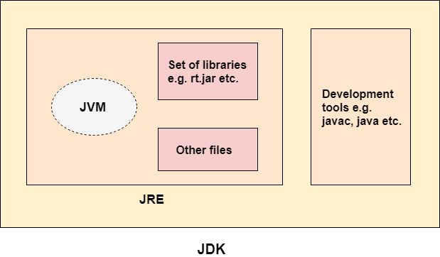
Java Development Kit (JDK)
JDK is an acronym for Java Development Kit.
The Java Development Kit (JDK) is a software development environment which is used to develop Java applications and applets.
It physically exists. It contains JRE + development tools.
The JDK contains a private Java Virtual Machine (JVM) and a few other resources such as an interpreter/loader (java), a compiler (javac), an archiver (jar), a documentation generator (Javadoc), etc. to complete the development of a Java Application.

Slide 24
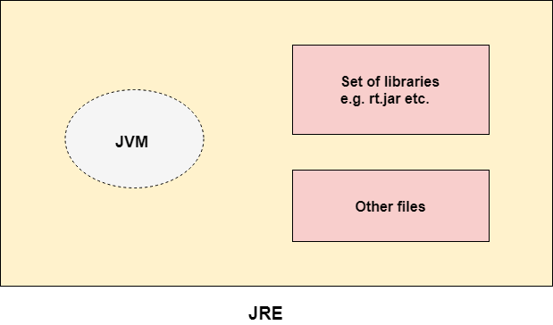
Java Runtime Environment (JRE)
JRE is an acronym for Java Runtime Environment.
It is also written as Java RTE.
The Java Runtime Environment is a set of software tools which are used for developing Java applications.
It is used to provide the runtime environment.
It is the implementation of JVM.
It physically exists.
It contains a set of libraries + other files that JVM uses at runtime.
The implementation of JVM is also actively released by other companies besides Sun Micro Systems.

Slide 25
Java Virtual Machine (JVM)
JVM (Java Virtual Machine) is an abstract machine. It is a specification that provides runtime environment in which java bytecode can be executed.
JVM is an interpreter. It is the main component of Java that makes java platform independent.
It is because the bytecode file can be taken onto any system and the JVM residing in that system will interpret and translate the byte code into machine readable code.
The JVM performs following operation:
Loads code
Verifies code
Executes code
Provides runtime environment

Slide 26
Tokens of Java
Character Set
Keywords
Identifiers
Constants & variables
Datatypes
operators

Slide 27
Character Set
Alphabets: Both lowercase (a, b, c, d, e, etc.) and uppercase (A, B, C, D, E, etc.).
Digits: 0, 1, 2, 3, 4, 5, 6, 7, 8, 9.
Special symbols: _, (, ), {, }, [, ], +, -, *, /, %, !, &, |, ~, ^, <, =, >, $, #, ?, Comma (,), Dot (.), Colon (:), Semi-colon (;), Single quote (‘), Double quote (“), Back slash (\).
White space: Space, Tab, New line.

Slide 28
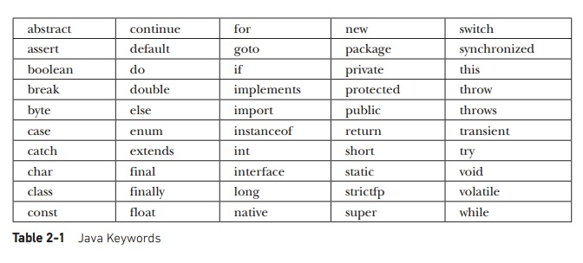
Keywords
There are 50 keywords currently defined in the Java language.
These keywords, combined with the syntax of the operators and separators, form the foundation of the Java language.
These keywords cannot be used as identifiers.
Thus, they cannot be used as names for a variable, class, or method.
In addition to the keywords, Java reserves the following: true, false, and null. These are values defined by Java. You may not use these words for the names of variables, classes, and so on.

Slide 29
Identifiers
Identifiers are used to name things, such as classes, variables, and methods.
An identifier may be any descriptive sequence of uppercase and lowercase letters, numbers, or the underscore and dollar-sign characters. (The dollar-sign character is not intended for general use.)
Following rules needs to be followed while creating identifiers
An identifier can consist of Alphabets, digits, and two special symbols _ (underscore) and $ (dollar)
An identifier cannot start with a digit. It has to start with an alphabet or _ or $
No other special symbols apart from _ and $ are allowed. Not even blank spaces.
An identifier cannot be a keyword.
It is case sensitive. That is firstName, FirstName, firstname are three different identifiers.

Slide 30
Identifiers
Exercise : Identify valid and invalid identifiers from the list given below –
simple_interest
char
3friends
_3$friends
Simple interest
#3friends
void
Void
$xyz

Slide 31
Constants and variables
A constant is an entity in programming that is immutable.
In other words, the value that cannot be changed after assigning it.
In java constants can be defined by using the keyword “final” before the datatype.
Constants are used to declare values that remain constant like value of pi.
Eg : final double pi=3.14;
Variables are containers for storing data values.
A variable is assigned with a data type.
A variable is the name of a reserved area allocated in memory.
In other words, it is a name of the memory location.
It is a combination of "vary + able" which means its value can be changed.
eg: int data=50; //Here data is a variable

Slide 32
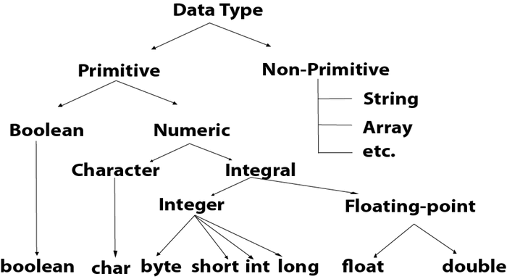
Datatypes
Data types specify the different sizes and values that can be stored in the variable.
There are two types of data types in Java:
Primitive data types: The primitive data types include boolean, char, byte, short, int, long, float and double.
Non-primitive data types: The non-primitive data types include Classes, Interfaces, and Arrays.

Slide 33
Datatypes
Data Type | Default Value | Default size | Range
boolean | false | 1 bit | true or false
char | '\u0000' | 2 byte | '\u0000' (or 0) to '\uffff' (or 65,535 inclusive).
byte | 0 | 1 byte | -128 to 127 (inclusive)
short | 0 | 2 byte | -32,768 to 32,767 (inclusive)
int | 0 | 4 byte | - 2,147,483,648 to 2,147,483,647 (inclusive)
long | 0L | 8 byte | -9,223,372,036,854,775,808 to 9,223,372,036,854,775,807 (inclusive)
float | 0.0f | 4 byte | -3.4e38 to 3.4e38
double | 0.0d | 8 byte | Its value range is unlimited

Slide 34
Operators
There are many types of operators in Java which are given below:
Unary Operator
Arithmetic Operator
Shift Operator
Relational Operator
Bitwise Operator
Logical Operator
Ternary Operator
Assignment Operator

Slide 35
Operators
Operator precedence
Operator Type | Category | Precedence
Unary | postfix | expr++ expr--
 | prefix | ++expr --expr +expr -expr ~ !
Arithmetic | multiplicative | * / %
 | additive | + -
Shift | shift | << >> >>>
Relational | comparison | < > <= >= instanceof
 | equality | == !=
Bitwise | bitwise AND | &
 | bitwise exclusive OR | ^
 | bitwise inclusive OR | |
Logical | logical AND | &&
 | logical OR | ||
Ternary | ternary | ? :
Assignment | assignment | = += -= *= /= %= &= ^= |= <<= >>= >>>=

Slide 36
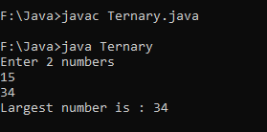
Ternary Operator
The operator that requires three operands is called as Ternary Operator.
Java supports only one ternary operator ? :
Syntax : (condition) ? (Value if true) : (value if false)
import java.util.*;
class Ternary{
public static void main(String args[]){
int a, b, large;
Scanner sc=new Scanner(System.in);
System.out.println("Enter 2 numbers");
a=sc.nextInt();
b=sc.nextInt();
large=(a>b)?a:b;
System.out.println("Largest number is : "+large);
} }

Slide 37
Comments
Single line Comments - // comments
Multi line comments - /* comments */
Documentation comments - /** comments */

Slide 38
Input/Output in Java
Output in Java
System.out.println(“Hello”);
System – class of Java.lang package
out – variable of class System corresponding to the std o/p device i.e. monitor
println()/print() – static methods for displaying content
Input in Java
BufferedReader – readLine()
Scanner – nextInt(), nextLong(), nextFloat(), nextDouble(), next(), nextLine()

Slide 39
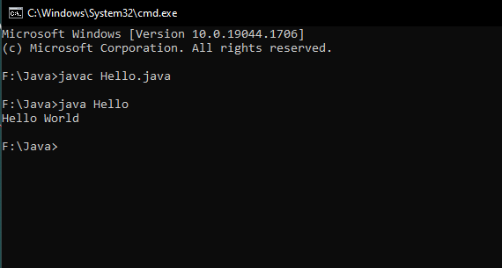
Simple Java Program
class Hello{
public static void main(String args[])
{
System.out.println("Hello World");
}
}
Output :

Slide 40
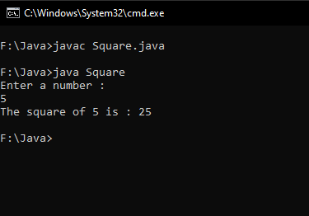
Program for accepting input (Scanner)
import java.util.*;
class Square{
public static void main(String args[])
{
int i, res;
Scanner sc=new Scanner (System.in);
System.out.println(“Enter a number : “);
i=sc.nextInt();
res=i*i;
System.out.println(“The square of “ + i + “ is : “ + res);
}
}

Slide 41
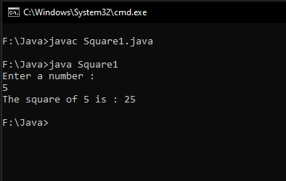
Program for accepting input (BufferedReader)
import java.io.*;
class Square{
public static void main(String args[]) throws IOException
{
int i, res;
BufferedReader br=new BufferedReader (new InputStreamReader(System.in));
String str;
System.out.println(“Enter a number : “);
str=br.readLine();
i=Integer.parseInt(str);
res=i*i;
System.out.println(“The square of “ + i + “ is : “ + res);
}
}

Slide 42
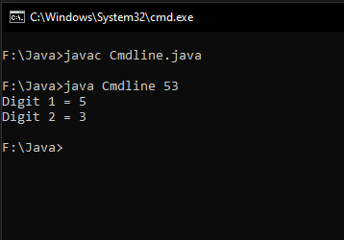
Program for accepting input (command line)
class Cmdline{
public static void main(String args[])
{
int n,d1,d2;
n=Integer.parseInt(args[0]);
d2=n%10;
d1=n/10;System.out.println("Digit 1 = "+d1+"\nDigit 2 = "+d2);
}
}

Slide 43
Typecasting in Java
Type casting is a method or process that converts a data type into another data type in both ways manually and automatically.
The automatic conversion is done by the compiler and manual conversion performed by the programmer
Converting a lower data type into a higher one is called as implicit conversion or casting down.
It is done automatically.
It takes place when:
Both data types must be compatible with each other.
The target type must be larger than the source type.
Eg : typecasting int to long
Converting a higher data type into a lower one is called as explicit conversion or casting up.
It is done manually by the programmer.
If we do not perform casting then the compiler reports a compile-time error.
Eg : typecasting float to byte
Syntax for explicit typecasting –
(target datatype)source datatype variable
Eg : float x;
(byte) x;

Slide 44
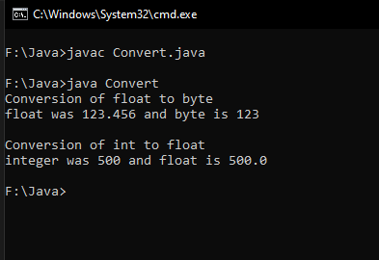
Typecasting in Java
class Convert{
public static void main(String args[])
{
byte b;
int i=500;
float f=123.456f;
System.out.println("Conversion of float to byte");
b=(byte) f; // explicit typecasting
System.out.println("float was "+f+ " and byte is "+b+"\n");
System.out.println("Conversion of int to float");
f=i; // implicit typecasting
System.out.println("integer was "+i+ " and float is "+f);
}
}

Slide 45
Control statements
Control statements are of two types
Conditional statements – if-else, switch case
Iterative statements – for, while, do while

Slide 46
Conditional Statements
If-Else statements
Switch statements
import java.util.*;
class PositiveNegativeExample {
public static void main(String[] args) {
int n;
Scanner sc=new Scanner (System.in);
System.out.println(“Enter n : “);
n=sc.nextInt();
if(n>0){
System.out.println("POSITIVE");
}
else if(n<0){
System.out.println("NEGATIVE");
}
else{
System.out.println("ZERO");
}
}
}
import java.util.*;
public class Main {
public static void main(String[] args) {
int day;
Scanner sc=new Scanner (System.in);
System.out.println(“Enter the day number : “);
day=sc.nextInt();
switch (day) {
case 1:
System.out.println("Monday");
break;
case 2:
System.out.println("Tuesday");
break;
case 3:
System.out.println("Wednesday");
break;
case 4:
System.out.println("Thursday");
break;
case 5:
System.out.println("Friday");
break;
case 6:
System.out.println("Saturday");
break;
case 7:
System.out.println("Sunday");
break;
}
}
}

Slide 47
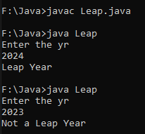
Conditional Statements
WAP to check if the user entered year is leap or not
import java.util.*;
class Leap {
public static void main(String[] args) {
int yr;
Scanner sc=new Scanner(System.in);
System.out.println("Enter the yr");
yr=sc.nextInt();
if((yr%4==0 && yr%100!=0)||(yr%100==0 && yr%400==0))
System.out.println("Leap Year");
else
System.out.println("Not a Leap Year");
} }

Slide 48
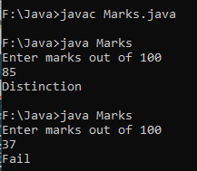
Conditional Statements
WAP to display the class according to the marks scored by student using switch case. The marks scored is taken input from the user and the class is displayed based on the range given below
import java.util.*;
class Marks {
public static void main(String[] args) {
int marks;
Scanner sc=new Scanner(System.in);
System.out.println("Enter marks out of 100");
marks=sc.nextInt();
if (marks==100)
System.out.println("Distinction");
switch(marks/10)
{
case 0:
case 1:
case 2:
case 3: System.out.println("Fail");
break;
case 4: System.out.println("Pass Class");
break;
case 5: System.out.println("Second Class");
break;
Marks | Class
70-100 | Distinction
60-69 | First
50-59 | Second
40-49 | Pass
0-39 | Fail
case 6: System.out.println("First Class");
break;
case 7:
case 8:
case 9: System.out.println("Distinction");
break;
default: System.out.println("InvalidMarks");
} } }

Slide 49
Iterative Statements
For loop
While loop
Do-while loop
import java.util.*;
class Natural{
public static void main(String args[])
{
int i, n;
Scanner sc=new Scanner (System.in);
System.out.println(“Enter n : “);
n=sc.nextInt();
for(i=1;i<=n;i++)
{
System.out.println(i);
}
}
}
import java.util.*;
class NaturalWhile{
public static void main(String args[])
{
int i, n;
Scanner sc=new Scanner (System.in);
System.out.println(“Enter n : “);
n=sc.nextInt();
i=1;
while(i<=n)
{
System.out.println(i);
i++;
}
}
}
import java.util.*;
class NaturalWhile{
public static void main(String args[])
{
int i, n;
Scanner sc=new Scanner (System.in);
System.out.println(“Enter n : “);
n=sc.nextInt();
i=1;
do
{
System.out.println(i);
i++;
}while(i<=n);
}
}

Slide 50
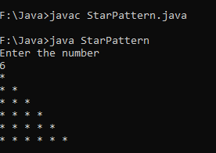
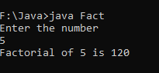
Iterative Statements
WAP to find factorial of a number
import java.util.*;
class Fact {
public static void main(String[] args) {
int n,i,fact=1;
Scanner sc=new Scanner(System.in);
System.out.println("Enter the number");
n=sc.nextInt();
for(i = 1; i <= n; i++)
{ fact = fact * i; }
System.out.println("Factorial of " + n + " is " + fact);
}
}
WAP to display the pattern
import java.util.*;
class StarPattern {
public static void main(String[] args) {
int n,i,j;
Scanner sc=new Scanner(System.in);
System.out.println("Enter the number");
n=sc.nextInt();
for(i=1;i<=n;i++)
{
for(j=1;j<=i;j++)
{
System.out.print("* ");
}
System.out.println();
} } }

Slide 51
Arrays (single dimensional)
an array is a collection of multiple data of same datatype
Indexing in an array starts from 0. The last index is n-1 where n is the size of the array.
Syntax for declaring array : datatype array_name[]=new datatype[array_size];
Eg : int arr[]=new int[10];

Slide 52
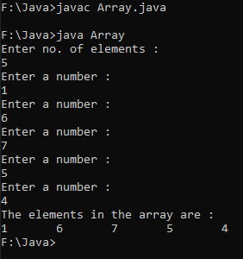
Arrays (single dimensional)
WAP to input and display n elements in an array
import java.util.*;
class Array{
public static void main(String args[])
{
int i,n;
Scanner sc=new Scanner(System.in);
System.out.println("Enter no. of elements : ");
n=sc.nextInt();
int a[]=new int[n];
for(i=0;i<=n-1;i++)
{
System.out.println("Enter a number : ");
a[i]=sc.nextInt();
}
System.out.println("The elements in the array are : ");
for(i=0;i<=n-1;i++)
{
System.out.print(a[i]+"\t");
} } }

Slide 53
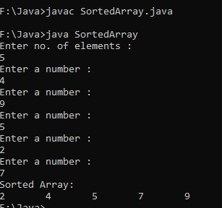
Arrays (single dimensional)
WAP to sort an array in ascending order
import java.util.*;
class SortedArray{
public static void main(String args[])
{
int i,n,temp;
Scanner sc=new Scanner(System.in);
System.out.println("Enter no. of elements : ");
n=sc.nextInt();
int a[]=new int[n];
for(i=0;i<=n-1;i++)
{
System.out.println("Enter a number : ");
a[i]=sc.nextInt();
}
for(i=0;i<=n-2;i++)
{
for(int j=0;j<=n-2;j++)
{
if(a[j]>a[j+1])
{
temp=a[j];
a[j]=a[j+1];
a[j+1]=temp;
}
}
}
System.out.println("Sorted Array: ");
for(i=0;i<=n-1;i++)
{
System.out.print(a[i]+"\t");
} } }

Slide 54
Arrays (multi dimensional)
The Java multidimensional arrays are arranged as an array of arrays i.e. each element of a multi-dimensional array is another array.
The representation of the elements is in rows and columns.
Thus, you can get a total number of elements in a multidimensional array by multiplying row size with column size.
So if you have a two-dimensional array of 3×4, then the total number of elements in this array = 3×4 = 12
The simplest of the multi-dimensional array is a two-dimensional array.
A simple definition of 2D arrays is: A 2D array is an array of one-dimensional arrays.
In Java, a two-dimensional array is stored in the form of rows and columns and is represented in the form of a matrix.
The general declaration of a two-dimensional array is,
data_type[][] array_name = new data_type[row_size][column_size];
Eg : int a[][]=new int[3][4];

Slide 55
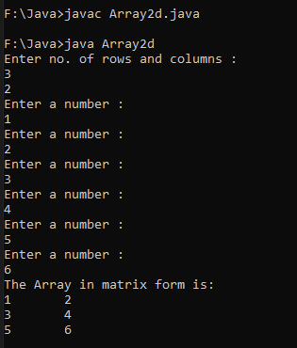
Arrays (multi dimensional)
import java.util.*;
class Array2d
{
public static void main(String[] args) {
int i,j,m,n;
Scanner sc=new Scanner(System.in);
System.out.println("Enter no. of rows and columns : ");
m=sc.nextInt();
n=sc.nextInt();
int a[][] = new int[m][n];
for (i=0;i<=m-1; i++) {
for (j=0;j<=n-1;j++) {
System.out.println("Enter a number : ");
a[i][j]=sc.nextInt();
} }
System.out.println("The Array in matrix form is:");
for (i=0;i<=m-1;i++) {
for (j=0;j<=n-1;j++) {
System.out.print(a[i][j]+"\t");
}
System.out.println();
} } }

Slide 56
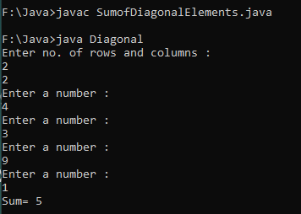
Arrays (multi dimensional)
WAP to find and display sum of the diagonal elements of a square matrix
import java.util.*;
class Diagonal
{
public static void main(String[] args) {
int i,j,m,n,sum=0;
Scanner sc=new Scanner(System.in);
System.out.println("Enter no. of rows and columns : ");
m=sc.nextInt();
n=sc.nextInt();
int a[][] = new int[m][n];
for (i=0;i<=m-1; i++) {
for (j=0;j<=n-1;j++) {
System.out.println("Enter a number : ");
a[i][j]=sc.nextInt();
} }
for (i=0;i<=m-1;i++) {
for (j=0;j<=n-1;j++) {
if(i==j)
sum=sum+a[i][j];
} }
System.out.println("Sum= "+sum);
} }

Slide 57
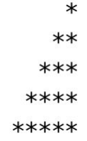
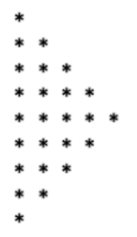
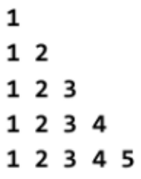
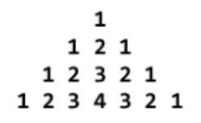
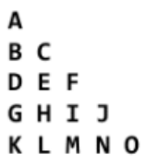

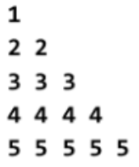
Programming Practice Questions
WAP to accept a number and display its equivalent ASCII character using type casting.
WAP to find largest of three numbers accepted from the user through command line using ternary operator.
WAP to display first n odd numbers
WAP to calculate and display sum of square of first n natural numbers.
WAP to display first n elements of Fibonacci series.
WAP to calculate value of following series – 1 + 1/2 + 1/3 + 1/4 +….+ 1/n
WAP to calculate value of following series – 1 + 1/2! + 1/3! + 1/4! +….+1/n!
WAP to calculate and display value of s for t=1,5,10,15,20,….,100. Formula : s = s₀ + v₀ + ½ a t²
WAP to display following patterns

Slide 58
Programming Practice Questions
WAP to count number of digits in a user entered number using while loop.
WAP to display a user entered number as a sequence of individual digits using while loop. Eg : 1691 should be displayed as 1 6 9 1
WAP to check if a user entered number is divisible by 3 and 5 or not.
WAP to check if the entered number is Armstrong number or not.
WAP to display the class according to the marks scored by student using if else if. The marks scored is taken input from the user and the class is displayed based on the range given below
WAP to display a user digit number in words using switch case. Eg : i/p : 123 o/p : One Two Three
WAP to find GCD and LCM of user entered two numbers.
WAP to find largest element from the array.
Marks | Class
70-100 | Distinction
60-69 | First
50-59 | Second
40-49 | Pass
0-39 | Fail

Slide 59
Programming Practice Questions
WAP to display average of n integers stored in an array
WAP to search an element in an array and if found display the index.
WAP to sort an array.
WAP to add two matrices of size m x n
WAP to find transpose of a matrix of size m x n
The annual examination results of 5 students are tabulated as follows
WAP to read the data and determine the following
Total marks obtained by each student
The highest total marks and the student who obtained highest total marks.
Roll No | Subject 1 | Subject 2 | Subject 3
1
2
3
4
5

Slide 60
JAVA PROGRAMMING
Chap 2 : Classes and Methods

Slide 61
In object-oriented programming technique, we design a program using objects and classes.
An object in Java is the physical as well as a logical entity, whereas, a class in Java is a logical entity only.
Method in Java is a collection of instructions that performs a specific task.
It provides the reusability of code. We can also easily modify code using methods.

Slide 62
Methods in Java
A method is a block of code or collection of statements or a set of code grouped together to perform a certain task or operation.
It is used to achieve the reusability of code.
We write a method once and use it many times.
We do not require to write code again and again.
It also provides the easy modification and readability of code, just by adding or removing a chunk of code.
The method is executed only when we call or invoke it.
The most important method in Java is the main() method.
The method declaration provides information about method attributes, such as visibility, return-type, name, and arguments.

Slide 63
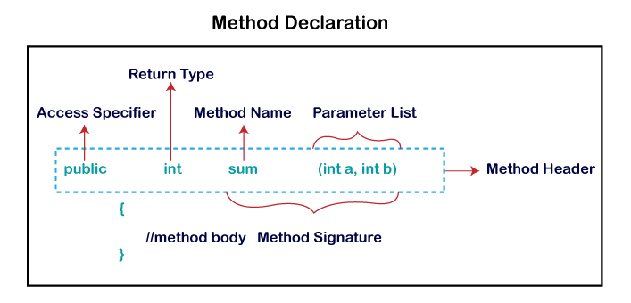
Methods in Java
It has six components that are known as method header, as we have shown in the following figure
Method Signature: Every method has a method signature. It is a part of the method declaration. It includes the method name and parameter list.
Access Specifier: Access specifier or modifier is the access type of the method. It specifies the visibility of the method. Java provides five types of access specifier
Return Type: Return type is a data type that the method returns. It may have a primitive data type, object, collection, void, etc. If the method does not return anything, we use void keyword.
Method Name: It is a unique name that is used to define the name of a method. It must be corresponding to the functionality of the method. A method is invoked by its name.
Parameter List: It is the list of parameters separated by a comma and enclosed in the pair of parentheses. It contains the data type and variable name. If the method has no parameter, we leave the parentheses blank. The parameters whose values are passed to the method are called as actual parameters and the variables in which the parameter values are received are called as formal parameters. Number of formal parameters should always be equal to number of actual parameters.
Method Body: It is a part of the method declaration. It contains all the actions to be performed. It is enclosed within the pair of curly braces.

Slide 64
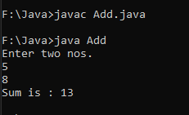
Methods in Java (Static Method Examples)
import java.util.*;
class Add{
public static void main(String args[])
{
int a,b,sum;
Scanner sc=new Scanner(System.in);
System.out.println("Enter two nos.");
a=sc.nextInt();
b=sc.nextInt();
sum=add(a,b);
System.out.println(“The Sum is : "+sum);
}
public static int add(int x, int y)
{
return(x+y);
}
}
import java.util.*;
class Add {
public static void main(String args[])
{
int a,b,sum;
Scanner sc=new Scanner(System.in);
System.out.println("Enter two nos.");
a=sc.nextInt();
b=sc.nextInt();
add(a,b);
}
public static void add(int x, int y)
{
System.out.println("The Sum is : "+(x+y));
}
}

Slide 65
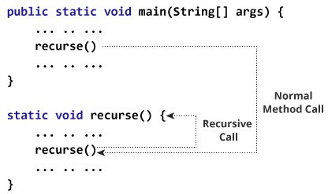
Recursive Methods
a method that calls itself is known as a recursive method.
And, this process is known as recursion.
In order to stop the recursive call, we need to provide some conditions inside the method. Otherwise, the method will be called infinitely.
Hence, we use the if...else statement(or similar approach) to terminate the recursive call inside the method.

Slide 66
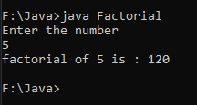
Recursive Methods
import java.util.*;
class Factorial{
public static void main(String[] args){
int n, f;
Scanner sc=new Scanner(System.in);
System.out.println("Enter the number");
n=sc.nextInt();
f=fact(n);
System.out.println("factorial of "+n+" is : "+f);
}
public static int fact(int x)
{
if(x==1)
return 1;
else
return(x*fact(x-1));
}
}

Slide 67
Java Access Specifiers
Access Modifier Access Location | Public | Protected (subclass and pkg) | Default (friendly) (in same pkg) | Private | Private Protected (class & its sub class)
Same Class | Yes | Yes | Yes | Yes | Yes
Sub class in same package | Yes | Yes | Yes | No | Yes
Other classes in same package | Yes | Yes | Yes | No | No
Subclass in other packages | Yes | Yes | No | No | Yes
Non-subclasses in other packages | Yes | No | No | No | No

Slide 68
Java Class
A class is a group of objects which have common properties.
It is a template or blueprint from which objects are created.
It is a logical entity. It can't be physical.
A class in Java can contain:
Fields
Methods
Constructors
Blocks
Nested class and interface
Syntax to declare a class:
class <class_name>{
field;
method;
}

Slide 69
Java Objects
An entity that has state and behavior is known as an object e.g., chair, bike, marker, pen, table, car, etc.
It can be physical or logical (tangible and intangible)
An object has three characteristics:
State: represents the data (value) of an object.
Behavior: represents the behavior (functionality) of an object such as deposit, withdraw, etc.
Identity: An object identity is typically implemented via a unique ID. The value of the ID is not visible to the external user. However, it is used internally by the JVM to identify each object uniquely.
An object is an instance of a class. A class is a template or blueprint from which objects are created. So, an object is the instance(result) of a class.
Object Definitions:
An object is a real-world entity.
An object is a runtime entity.
The object is an entity which has state and behavior.
The object is an instance of a class.

Slide 70
Java Objects
We can make objects of the class and memory space will be allocated to the fields of that object.
The methods of a class can be accessed using the objects using the dot(.) operator.
Syntax of making an object of a class is –
class_name object_name = new class_name(parameters to be passed)
Eg : WAP to create a class Circle. It should have three methods namely accept radius, calculate area and display the area.

Slide 71
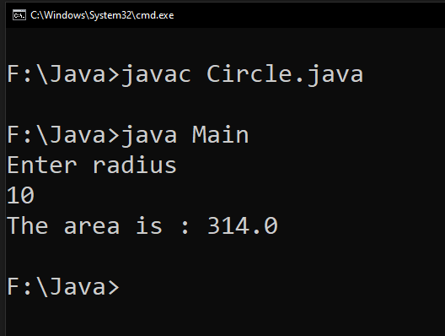
import java.util.*;
class Circle{
private float r,area;
public void accept(float x)
{
r=x;
}
public void calculate()
{
area=3.14f*r*r;
}
public void display()
{
System.out.println("The area is : "+area);
}
}
class Main{
public static void main(String args[])
{
float rad;
Scanner sc=new Scanner(System.in);
System.out.println("Enter radius");
rad=sc.nextFloat();
Circle c=new Circle();
c.accept(rad);
c.calculate();
c.display();
}
}

Slide 72
Constructor
A constructor in Java is a special method that is used to initialize objects.
The constructor is called when an object of a class is created.
It can be used to set initial values for object attributes
At the time of calling constructor, memory for the object is allocated
Every time an object is created using the new() keyword, at least one constructor is called.
It calls a default constructor if there is no constructor available in the class.
In such case, Java compiler provides a default constructor by default.
There are two types of constructors in Java: no-arg(i.e. default) constructor, and parameterized constructor.
It is called constructor because it constructs the values at the time of object creation.
It is not necessary to write a constructor for a class. It is because java compiler creates a default constructor if your class doesn't have any.

Slide 73
Constructor
Rules for creating constructors :
Constructor should always be public/default/protected.
Name of the constructor should always be same as that of the class
Constructor should not have a return type, not even void.
Constructor is automatically called when an object of the class is created
There can be more than one constructor having same name but different parameter list. This is known as Constructor Overloading
There are the following reasons to use constructors:
We use constructors to initialize the object with the default or initial state. The default values for primitives may not be what are you looking for.
Another reason to use constructor is that it informs about dependencies. In other words, using the constructor, we can request the user of that class for required dependencies.
We can find out what it needs in order to use this class, just by looking at the constructor.
In short, we use the constructor to initialize the instance variable of the class.

Slide 74
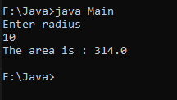
Default Constructor Example
import java.util.*;
class CircleDefConst{
private float r,area;
CircleDefConst()
{
Scanner sc=new Scanner(System.in);
System.out.println("Enter Radius");
r=sc.nextFloat();
}
public void calculate()
{
area=3.14f*r*r;
}
public void display()
{
System.out.println("The area is : "+area);
} }
class Main{
public static void main(String args[])
{
// Default Constructor
CircleDefConst c=new CircleDefConst();
c.calculate();
c.display();
}
}

Slide 75
Parameterized Constructor Example
import java.util.*;
class Circle{
private float r,area;
Circle(float x)
{
r=x;
}
void calculate()
{
area=3.14f*r*r;
}
void display()
{
System.out.println("The area is : "+area);
}
}
class Main{
public static void main(String args[])
{
float rad;
Scanner sc=new Scanner(System.in);
System.out.println("Enter radius");
rad=sc.nextFloat();
// parameterized constructor
Circle c=new Circle(rad);
c.calculate();
c.display();
}
}

Slide 76
Constructor Overloading
Multiple constructors of same class with different parameters is called constructor overloading
Eg : Program on next slide (slide 18)

Slide 77
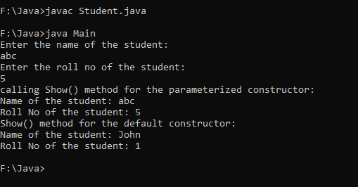
import java.util.Scanner;
class Student
{
private String name;
private int roll_no;
//parameterized constructor
Student(String n, int rn)
{
name=n;
roll_no=rn;
}
//Default constructor
Student()
{
name = "John";
roll_no = 1;
}
//method for printing the values
void show()
{
System.out.println("Name of the student: "+name);
System.out.println("Roll No of the student: "+roll_no);
}
}
class Main{
public static void main(String args[])
{
Scanner sc = new Scanner(System.in);
System.out.println("Enter the name of the student: ");
String fname = sc.nextLine();
System.out.println("Enter the roll no of the student: ");
int rno = sc.nextInt();
//Calling the parameterized constructor
System.out.println("calling Show() method for the parameterized constructor: ");
Student s=new Student(fname, rno);
s.show();
//Calling the default constructor
System.out.println("Show() method for the default constructor: ");
Student s1=new Student();
s1.show();
} }

Slide 78
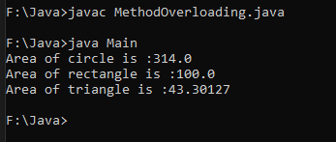
Method Overloading
Multiple methods with same name in same class or in base class and derived class with different parameters is called method overloading
Eg1 : WAP to demonstrate Method Overloading by overloading the methods for calculating Area of circle, rectangle and triangle
class MethodOverloading{
private float a;
public void area(float r)
{
a=3.14f*r*r;
System.out.println("Area of circle is :"+a);
}
public void area(float l, float b)
{
a=l*b;
System.out.println("Area of rectangle is :"+a);
}
public void area(float s1, float s2, float s3)
{
float s;
s=0.5f*(s1+s2+s3);
s=s*(s-s1)*(s-s2)*(s-s3);
a=(float)(Math.sqrt(s));
System.out.println("Area of triangle is :"+a);
}}
class Main {
public static void main(String args[]){
MethodOverloading obj=new MethodOverloading();
obj.area(10);
obj.area(10,10);
obj.area(10,10,10);
}}

Slide 79
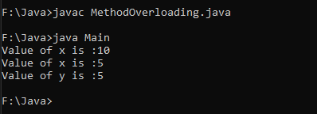
Method Overloading
Eg2 : WAP to demonstrate Method Overloading in a base and derived class by overloading the methods for displaying the value of variable contained in the class.
class Parent{
public void display(int x)
{
System.out.println("Value of x is :"+x);
}
}
class Child extends Parent{
public void display(int x, int y)
{
System.out.println("Value of x is :"+x+"\nValue of y is :"+y);
}
}
class Main {
public static void main(String args[]){
Child c=new Child();
c.display(10);
c.display(5,5);
}}

Slide 80
Array of Objects
Array of objects is created to store information about multiple objects having similar functionality.
Syntax : class_name object_name[] = new class_name[size of the array]
Eg : Student s[]=new Student[10];
Note: memory is not allocated to each object with the above declaration. We need to use “new” keyword with every object of the array separately for allocating memory.
Problem : WAP to create an array of objects of a class student. The class should have field members name, id, total marks and marks in three subjects namely Physics, Chemistry and Maths. Accept information of ‘n’ students and display them in tabular form.

Slide 81
import java.util.Scanner;
class Student
{
private String name;
private int id,p,c,m,t;
void accept()
{
Scanner sc=new Scanner(System.in);
System.out.println("Enter name, ID, Marks in Physics, Chemistry and Maths : ");
name=sc.nextLine();
id=sc.nextInt();
p=sc.nextInt();
c=sc.nextInt();
m=sc.nextInt();
t=p+c+m;
}
void display()
{
System.out.println(name+"\t"+id+"\t"+p+"\t"+c+"\t"+m+"\t"+t);
}
}
class Main{
public static void main(String args[])
{
int i,n;
Scanner sc = new Scanner(System.in);
System.out.println("Enter total number of students: ");
n = sc.nextInt();
//creating array of objects of size n
Student s[]=new Student[n];
for(i=0;i<=n-1;i++)
{
System.out.println("For student "+(i+1));
s[i]=new Student();
s[i].accept();
}
System.out.println("Name\tID\tPhy\tChem\tMaths\tTotal");
for(i=0;i<=n-1;i++)
{
s[i].display();
}
}
}

Slide 82
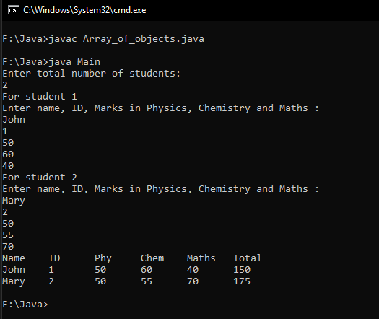

Slide 83
Static Class Members
A method or a field can be static.
static keyword is used to declare class members as static
A static method is a method that works on a class and not on the object of the class.
To call a static method we need not make object of that class
A static method is called by syntax : class_name.method_name()
A static field member or a static variable will be common for all the objects of that class.
A common memory location is allocated for a static variable for all objects made of that class
One of the major advantage of using static variable is that we can use it to count number of objects made of the class. Since each object will access the same memory location for static variable, we can increment its value in the constructor of class.
Whenever the object is created, this constructor will be called and this static variable will be incremented.

Slide 84
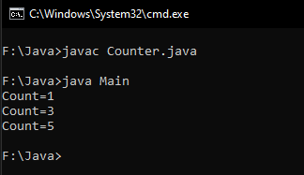
import java.util.Scanner;
class Counter
{
private static int count;
Counter()
{
count++;
} static void display()
{
System.out.println("Count="+count);
}
}
class Main{
public static void main(String args[])
{
Counter c1=new Counter();
Counter.display();
Counter c2=new Counter();
Counter c3=new Counter();
Counter.display();
Counter c4=new Counter();
Counter c5=new Counter();
Counter.display(); }
}

Slide 85
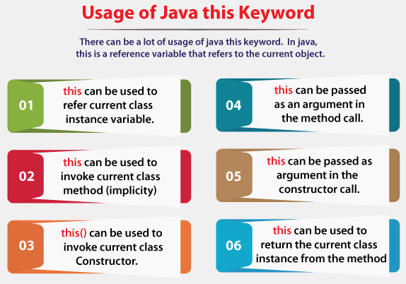
“this” keyword
this keyword refers to the current object.
this can also be used to:
Invoke current class constructor
Invoke current class method
Return the current class object
Pass an argument in the method call
Pass an argument in the constructor call

Slide 86
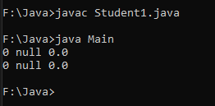
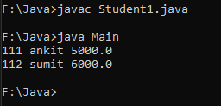
Eg1 : Without this keyword
class Student1{
int rollno;
String name;
float fee;
Student1(int rollno,String name,float fee){
rollno=rollno;
name=name;
fee=fee;
}
void display(){System.out.println(rollno+" "+name+" "+fee);} }
class Main{
public static void main(String args[]){
Student1 s1=new Student1(111,"ankit",5000f);
Student1 s2=new Student1(112,"sumit",6000f);
s1.display();
s2.display();
}}
Eg2 : With this keyword
class Student1{
int rollno;
String name;
float fee;
Student1(int rollno,String name,float fee){
this.rollno=rollno;
this.name=name;
this.fee=fee;
}
void display(){System.out.println(rollno+" "+name+" "+fee);}
}
class Main {
public static void main(String args[]){
Student1 s1=new Student1(111,"ankit",5000f);
Student1 s2=new Student1(112,"sumit",6000f);
s1.display();
s2.display();
}}
In the above eg1, parameters (formal arguments) and instance variables are same. So, we are using this keyword in eg2 to distinguish local variable and instance variable.

Slide 87
Programming Practice Questions
Create a class Employee with data members emp_id, name, designation and salary. Write methods get_details() to take employee details from the user and show_grade() to display grade of employees based on salary range as given below and show_details() to display employee details.
Create a class student with appropriate data members and methods to store and display Roll No, Name and marks stored by students in Physics, Chemistry and Maths.
WAP to demonstrate Method Overloading by overloading the method for calculating sum. Consider taking different parameter list in terms of no. of parameters and type of parameters.
WAP to demonstrate Constructor Overloading by overloading the constructor for taking radius input for calculating area of a circle.
WAP to implement a class Stack using array with two methods push and pop to add and remove elements from the stack. Addition of elements should not be allowed if the stack is full and popping should not be allowed if the stack is empty.
Salary Range | Grade
<10000 | D
10000-24999 | C
25000-49999 | B
>50000 | A

Slide 88
JAVA PROGRAMMING
Chap 3 : Inheritance

Slide 89
Inheritance is an important pillar of OOP(Object-Oriented Programming).
It is the mechanism in java by which one class is allowed to inherit the features(fields and methods) of another class.
In Java, inheritance means creating new classes based on existing ones.
A class that inherits from another class can reuse the methods and fields of that class.
In addition, you can add new fields and methods to your current class as well.
Inheritance represents the IS-A relationship which is also known as a parent-child relationship.
Important terminologies used in Inheritance:
Class: Class is a set of objects which shares common characteristics/ behavior and common properties/ attributes. Class is not a real-world entity. It is just a template or blueprint or prototype from which objects are created.
Super Class/Parent Class/Base Class: The class whose features are inherited is known as a superclass(or a base class or a parent class).
Sub Class/Child Class/Derived Class: The class that inherits the other class is known as a subclass(or a derived class, extended class, or child class). The subclass can add its own fields and methods in addition to the superclass fields and methods.
Reusability: Inheritance supports the concept of “reusability”, i.e. when we want to create a new class and there is already a class that includes some of the code that we want, we can derive our new class from the existing class. By doing this, we are reusing the fields and methods of the existing class.

Slide 90
Why do we need Inheritance in Java?
Code Reusability: The code written in the Superclass is common to all subclasses. Child classes can directly use the parent class code.
Method Overriding: Method Overriding is achievable only through Inheritance. It is one of the ways by which java achieves Run Time Polymorphism.
Abstraction: The concept of abstract where we do not have to provide all details is achieved through inheritance. Abstraction only shows the functionality to the user.
Syntax for inheritance
The extends keyword is used for inheritance in java. Using the extends keyword indicates you are derived from an existing class. In other words, “extends” refers to increased functionality.
Syntax : class derived_class extends base_class
{
//methods and fields
}
Types of Inheritance :
Single Inheritance
Multilevel Inheritance
Hierarchical Inheritance

Slide 91


Single Inheritance
Here only one class is derived from another class.
import java.util.*;
class Data { // Base class Data
float r;
public void read(float x)
{
r=x;
}}
class Area extends Data // creating child class Area
{
private float a;
public void calculate()
{
a=3.14f*r*r;
}
public void display()
{
System.out.println("Area is : "+a);
}}
class Main
{
public static void main(String args[])
{
float rad;
Scanner sc=new Scanner(System.in);
System.out.println("Enter Radius : ");
rad=sc.nextFloat();
Area ar=new Area();
ar.read(rad);
ar.calculate();
ar.display();
}}

Slide 92


Multilevel Inheritance
Here one class is derived from a class which is in turn derived from another class.
import java.util.*;
class Data { // Base class Data
float r;
public void read(float x)
{
r=x;
}}
class Area extends Data // creating child class Area of parent class Data
{
protected float a;
public void calculate()
{
a=3.14f*r*r;
}
public void display()
{
System.out.println("Area is : "+a);
}}
class Volume extends Area // creating child class Volume of parent class Area
{
private float vol;
public void compute()
{
vol=a*r*4/3;
}
public void show()
{
System.out.println("Volume is : "+vol);
}}
class Main
{
public static void main(String args[])
{
float rad;
Scanner sc=new Scanner(System.in);
System.out.println("Enter Radius : ");
rad=sc.nextFloat();
Volume v=new Volume();
v.read(rad);
v.calculate();
v.display();
v.compute();
v.show();
}
}

Slide 93

Hierarchical Inheritance
When multiple classes are derived from a class and further more classes are derived from these derived classes
one class serves as a superclass (base class) for more than one subclass
Example from codes

Slide 94
Hierarchical Inheritance
// parent class
class Employee {
double salary = 50000;
void displaySalary() {
System.out.println("Employee Salary: Rs."+salary);
}
}
// child class 1
class FullTimeEmployee extends Employee{
double hike = 0.50;
void incrementSalary() {
salary = salary + (salary * hike);
System.out.println("Full Time Employee Salary after increement : "+salary);
}
}
// child class 2
class InternEmployee extends Employee{
double hike = 0.25;
void incrementSalary() {
salary = salary + (salary * hike);
System.out.println("Intern Salary after increement : "+salary);
}}
class Main {
public static void main(String[] args) {
// object created
FullTimeEmployee emp1 = new FullTimeEmployee();
InternEmployee emp2 = new InternEmployee();
System.out.println("Salary of a full-time employee before incrementing:");
emp1.displaySalary();
emp1.incrementSalary(); // salary incremented of Full time Employee
System.out.println("Salary of an intern before incrementing:");
emp2.displaySalary();
emp2.incrementSalary(); // salary incremented of Intern
}}

Slide 95

Hierarchical Inheritance

Slide 96
Method Overriding
If a base class and derived class have a method with same name but different parameter list, then it is called as method overloading.
But, If a base class and derived class have a method with same name and same parameter list, then it is called as method overriding.
Usage of Java Method Overriding
Method overriding is used to provide the specific implementation of a method which is already provided by its superclass.
Method overriding is used for runtime polymorphism
Rules for Java Method Overriding
The method must have the same name as in the parent class
The method must have the same parameter as in the parent class.
There must be an IS-A relationship (inheritance).

Slide 97

Method Overriding
class Bank{
int getRateOfInterest()
{
return 0;
}}
class SBI extends Bank{
int getRateOfInterest()
{
return 8;
}}
class ICICI extends Bank{
int getRateOfInterest()
{
return 7;
}}
class AXIS extends Bank{
int getRateOfInterest()
{
return 9;
}}
class Main{
public static void main(String args[]){
SBI s=new SBI();
ICICI i=new ICICI();
AXIS a=new AXIS();
System.out.println("SBI Rate of Interest: "+s.getRateOfInterest());
System.out.println("ICICI Rate of Interest: "+i.getRateOfInterest());
System.out.println("AXIS Rate of Interest: "+a.getRateOfInterest());
}}

Slide 98
Final class and “final” keyword
The final keyword can be preceded to any member of a class or to the class itself.
Making anything final has following implications –
If the field member is declared final then the variable value cannot be changed i.e. it becomes constant.
If a method is declared as final then that method cannot be overridden
If a class is declared as final then that class cannot have any sub class i.e. no class can be derived from a final class

Slide 99

Final class and “final” keyword
Final variable : If you make any variable as final, you cannot change the value of final variable(It will be constant).
Example of final variable : There is a final variable speedlimit, we are going to change the value of this variable, but it can't be changed because final variable once assigned a value can never be changed.
class Bike{
final int speedlimit=90; //final variable
void run(){
speedlimit=400; // changing value of speedlimit
}
}
class Main{
public static void main(String args[]){
Bike b=new Bike();
b.run();
}
}

Slide 100

Final class and “final” keyword
Final method : If you make any method as final, you cannot override it.
class Bike{
final void run()
{
System.out.println("running");
}
}
class Honda extends Bike{
void run() // overriding final method run()
{
System.out.println("running safely with 100kmph");
}
}
class Main{
public static void main(String args[]){
Honda h= new Honda();
h.run();
}
}

Slide 101

Final class and “final” keyword
Final class : If you make any class as final, you cannot extend it.
final class Bike{
}
class Honda extends Bike{ // inheriting from final class bike
void run()
{
System.out.println("running safely with 100kmph");
}
}
class Main{
public static void main(String args[]){
Honda h= new Honda();
h.run();
}
}

Slide 102

Java Abstract class and method
Abstract classes are used to declare common characteristics of subclasses.
Abstract classes are declared with keyword abstract followed by class definition. They provide template for subclasses.
No object can be made of abstract class. It can be used as a base class for other classes that are derived from the abstract class.
An abstract class can contain fields and methods. It can have abstract and non-abstract methods (method with the body).
Methods of abstract class that has only declaration and no definition are known as Abstract Methods.
Abstract methods must be overridden.
If a class has any abstract method, the class becomes abstract and must be declared as abstract.

Slide 103

Java Abstract class and method
import java.util.*;
abstract class Abst { //abstract class
protected float r,vol;
public void read(float x) // non-abstract method
{
r=x;
}
public abstract void calculate(); // abstract method
public void display()
{
System.out.println("Volume = "+vol);
}}
class Sphere extends Abst {
public void calculate() // overriding abstract method
{
vol=3.14f*r*r*r*4/3;
}}
class Hemisphere extends Abst {
public void calculate() // overriding abstract method
{
vol=3.14f*r*r*r*2/3;
}}
class Main
{
public static void main(String args[])
{
float rad;
Scanner sc=new Scanner(System.in);
System.out.println("Enter Radius : ");
rad=sc.nextFloat();
Sphere s=new Sphere();
s.read(rad);
s.calculate();
System.out.println("For Sphere : ");
s.display();
Hemisphere h=new Hemisphere();
h.read(rad);
h.calculate();
System.out.println("For Hemisphere : ");
h.display();
}
}

Slide 104

The super keyword
The super keyword in Java is a reference variable which is used to refer immediate parent class object.
If you want to access a member of a base class from the derived class, then the super keyword is used.
This is especially to access the constructors and methods of base class.
Whenever you create the instance of subclass, an instance of parent class is created implicitly which is referred by super reference variable.

Slide 105

The super keyword
class Parent{
public Parent(int a)
{
System.out.println("Inside the constructor of Parent class : "+a);
}
public void display(int x)
{
System.out.println("x = "+x);
}
}
class Child extends Parent{
public Child(int a)
{
super(a);
System.out.println("Inside the constructor of Child class : "+a);
}
public void display(int y)
{
super.display(y);
System.out.println("y = "+y);
}}
class Main{
public static void main(String args[])
{
Child c = new Child(3);
c.display(5);
}
}

Slide 106


Slide 107


